Slide 1



THE BRANCH AND BOUND ALGPRITHM
SCHOOL:KELDEN UNIVERSITY
DEPARTMENT:SOFTWARE ENG
COURSE:ALGORITHM

Slide 2
Introduction:
The Branch and Bound (B&B) algorithm is a popular method used in various fields of computer science, operations research, and mathematical optimization to solve combinatorial optimization problems. It was first proposed by Ailsa Land and Alison Doig in 1960.Principle of the Algorithm The B&B algorithm operates on two main principles:
Branching: The algorithm recursively splits the search space into smaller spaces.
Bounding: The algorithm keeps track of bounds on the minimum that it is trying to find, and uses these bounds to "prune" the search space, eliminating candidate solutions that it can prove will not contain an optimal solution.

Slide 3

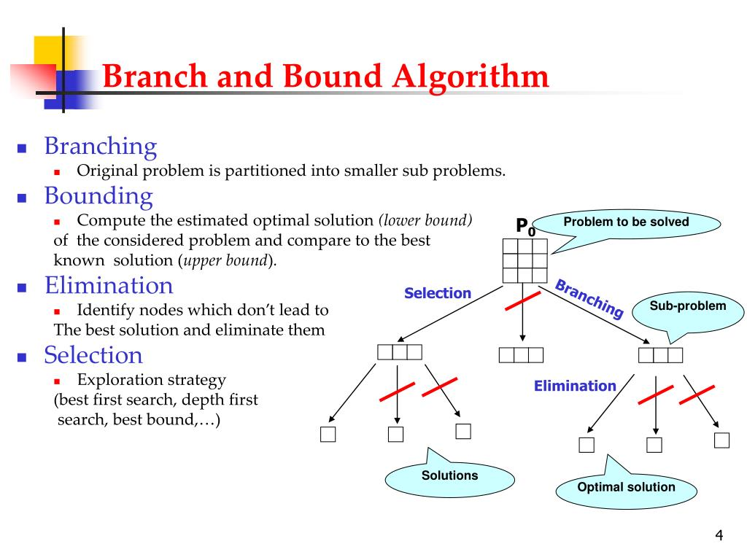
What is the B&B Algo..?
The Branch and Bound algorithm is a method used for solving optimization problems, particularly in decision making and operational research. It involves a systematic enumeration of all candidate solutions, where large subsets of fruitless candidates are discarded en masse, by using upper and lower estimated bounds of the quantity being optimized.

Slide 4
How It Works..!!
Branching phase:
Initialization phase:
Generate the subproblems. This is done by applying all possible decisions to the current problem, which results in a set of smaller subproblems. Each subproblem corresponds to a node in the tree.
Start with a problem and represent it as a tree. The root of the tree represents the initial state of the problem. The branches represent the decisions leading to the subproblems, and the leaf nodes represent the feasible solutions.
Selection phase:
Bounding phase:
Choose the next subproblem to explore. This is typically done using a priority queue, where the subproblems are ordered according to their bounds. The subproblem with the best bound is selected for further exploration.
For each subproblem, calculate a bound on the best possible solution that can be obtained. This bound is used to determine whether the subproblem is worth exploring further. If the bound is worse than the best known solution, the subproblem can be discarded.
Termination phase:
The algorithm terminates when there are no more subproblems to explore. The best solution found during the exploration of the tree is the optimal solution.

Slide 5


The Algorithm

Slide 6
Explanation:
Initialization: Set the variable Low-cost to infinity (∞)
This variable will keep track of the lowest cost found so far
The live_node_set is initialized with the root node of the problem.
While Loop: The algorithm continues as long as the live_node_set is not empty. The live_node_set contains nodes that have been generated but whose children have not been explored yet.
Node Selection: Choose a node k from the live_node_set. This node is called the "E-node" or "exploring node".
Update Live Node Set: Remove the selected node k from the live_node_set
Child Generation: Generate the children of node k and calculate their lower bounds. The set Sk contains pairs (i, zi), where i is a child of k and zi is its lower bound.-
Child Processing: For each child i in Sk, do the following:
If the lower bound zi of child i is greater than U (the best solution found so far), then discard or "kill" child i. This is because i cannot lead to a better solution than what we already have.
Otherwise, if child i is a solution and its cost zi is less than U, then update U to zi and update the current best solution to i.
If child i is not a solution, add it to the live_node_set for further exploration.
Termination: The algorithm terminates when there are no more live nodes to explore, i.e., when live_node_set becomes empty. At this point, the best solution found is the optimal solution

Slide 7
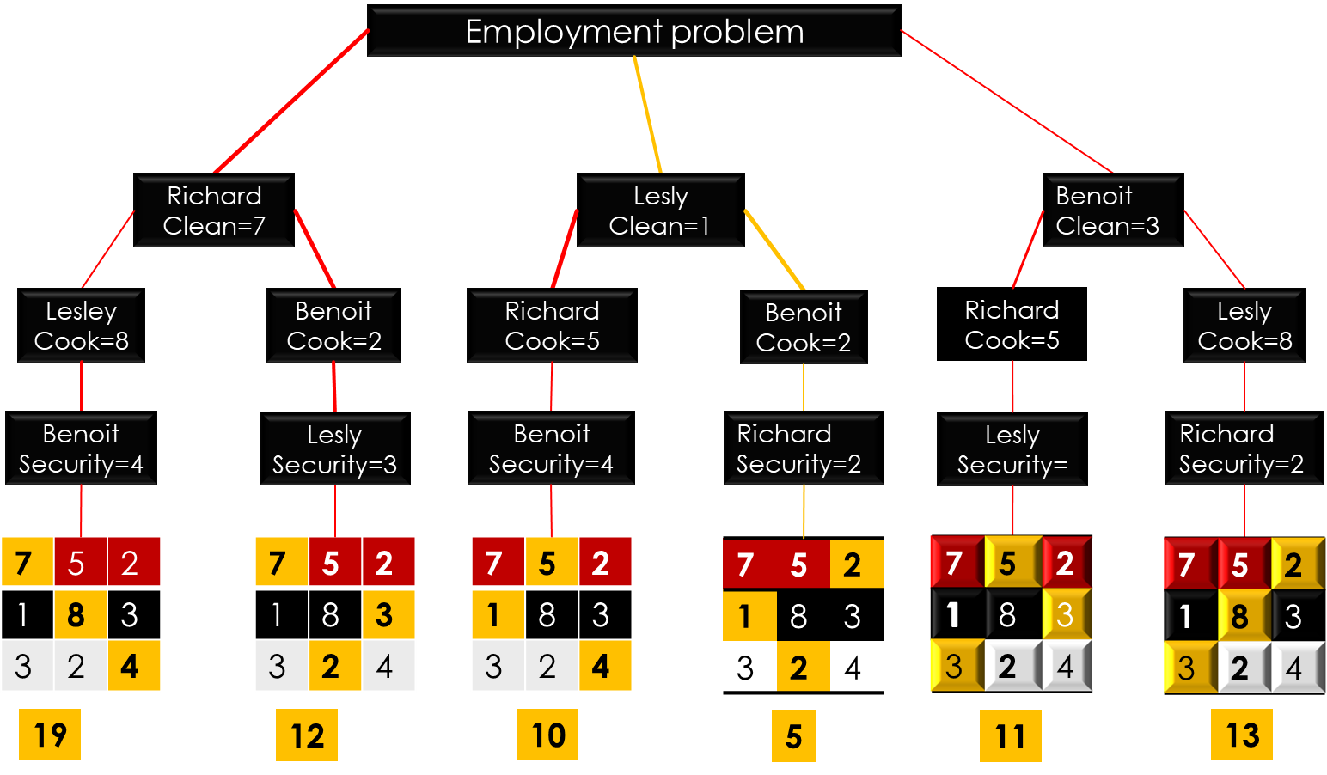
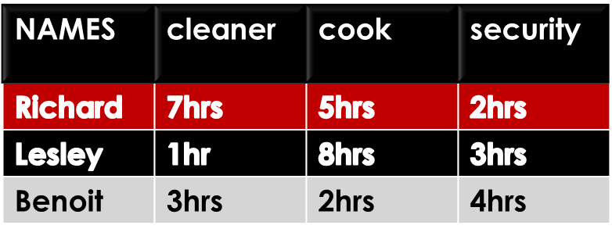
Use Case: "Implementation”
Job employment problem
Let’s consider a situation where 3 persons well qualified for 3 jobs apply for the jobs and the employee is faced is faced with the problem of having to employ them such that the jobs will be done at best capacity by with shortest of time.
Because time is the test factor. The employee want’s that all these jobs are done with smallest time posible but doesn’t know how he will employ them in order to achieve this so he decides to use a system that will help him select .

Slide 8
Situations:
The Branch and Bound algorithm is used for solving combinatorial optimization problems. These problems are typically exponential in terms of time complexity and may require exploring all possible permutations in the worst case.
Best case:
Worst case:
Best Case: The best case scenario for the Branch and Bound algorithm occurs when an optimal solution is found early in the search process. In this case, the algorithm can prune large portions of the search tree, thereby reducing the number of nodes that need to be explored.
Worst Case: The worst case scenario for the Branch and Bound algorithm occurs when the algorithm needs to explore the entire state space. This happens when the algorithm cannot prune any branches and must explore all possible permutations. The worst-case complexity of any branch-and-bound algorithm is exponential.
However, it’s important to note that while the worst-case complexity is exponential, the average complexity of the algorithm is significantly lower. This is because the algorithm is able to prune many branches in practice, reducing the number of nodes that need to be explored.

Slide 9
Search Techniques:
The Branch and Bound algorithm incorporates different search techniques to traverse a state space tree. Here are some of them:
DFS (Depth-First Search): Also known as a LIFO search, it maintains the list of live nodes in last-in-first-out order, i.e., in a stack. The live nodes are searched in the LIFO order to make them the next E-nodes.
LC Search (Least Cost Search):This technique uses a heuristic cost function to compute the bound values at each node. Nodes are added to the list of live nodes as soon as they get generated. The node with the least value of a cost function is selected as the next E-node
BFS (Breadth-First Search): Also known as a FIFO search, it maintains the list of live nodes in first-in-first-out order, i.e., in a queue. The live nodes are searched in the FIFO order to make them the next E-nodes.

Slide 10
Observations:
Here are some observations done with respect to this algorithm
ADVANTAGES
DISADVANTAGES
Efficiency: Branch and Bound does not explore all the nodes in the tree, which makes it less time-consuming compared to some other algorithms.
Optimality: If the problem is not large and if branching can be done in a reasonable amount of time, Branch and Bound finds an optimal solution.
It provides a systematic approach for solving optimization problems.
Time-Consuming: It can be extremely time-consuming: the number of nodes in a branching tree can be too large.
Exponential Time Complexity: It often leads to exponential time complexities in the worst case.
Difficult Parallelization: The load balancing aspects for Branch and Bound algorithm make its parallelization difficult.
Limited to Small Size Network: It is limited to small size network. In the problem of large networks, where the solution search space grows exponentially with the scale of the network, the approach becomes relatively prohibitive.

Slide 11
Conclusion:
The Branch and Bound algorithm is a powerful tool for solving discrete and combinatorial optimization problems.
It provides us with a systematic way of exploring the solution space in an efficient manner, by effectively pruning branches that do not lead to an optimal solution. This allows us to find the optimal solution in a reasonable amount of time, even for problems with a large number of variables.However, it's important to note that the efficiency of the algorithm heavily depends on the problem at hand, the bounding function used, and the strategy for exploring nodes. In some cases, the algorithm can still be time-consuming and may not be practical for problems of large size or where the solution space grows exponentially .
As a student, studying the Branch and Bound algorithm has provided me with valuable insights into optimization techniques and problem-solving strategies.
It has challenged me to think critically about how to approach complex problems and has equipped me with the skills to develop efficient algorithms. I look forward to applying these learnings in future projects and exploring further improvements and variations of the Branch and Bound algorithm.

Slide 12
THANK’S
HOPE YOU WERE EJOYED YOUR TIME WITH US……………………….

